Slide 1

Bidarahalli, Virgo Nagar Post,, Bangalore-560049, Karnataka, India. Department of Electronics and Communication Engineering,
PROBLEM STATEMENT: Protecting User Password Keys at Rest
(on the Disk)
PRESENTER:
Thejashwini H A
USN:1EP21EC107
COLLEGE MENTOR:
Malini V L

Slide 2
PROJECT OVERVIEW
This project implements a robust file encryption and decryption tool using Python's Tkinter for the GUI and cryptography libraries.
It employs AES-256 encryption for strong security.
Manages keys derived from user passwords with PBKDF2.
The application allows users to encrypt and decrypt files.
Stores encryption keys and hints securely on disk.
Handles password validation with optional hint retrieval after failed attempts.
Ensures data confidentiality and integrity.

Slide 3
FEATURES
File Selection: Allows users to select files for encryption or decryption.
Password Security: Ensures secure password input and validation.
AES-256 Encryption: Uses robust encryption for data confidentiality.
Decryption Capability: Provides decryption of files with the correct password.
Key Management: Implements secure key derivation with PBKDF2HMAC and uses salt for enhanced security.
User-Friendly Interface: Intuitive GUI with error handling for smooth operation

Slide 4
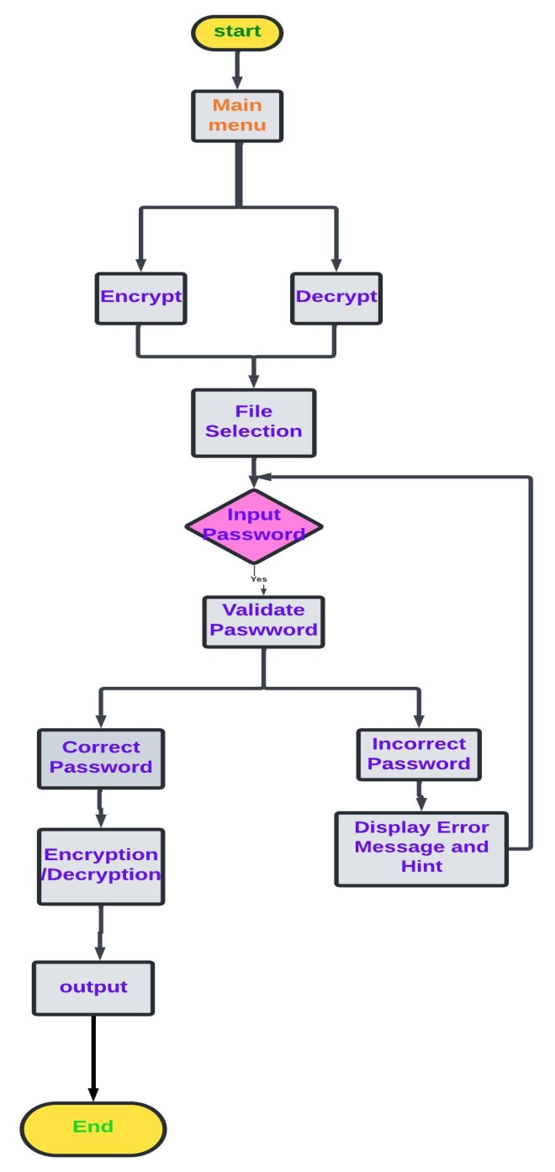
PROCESS FLOW

Slide 5
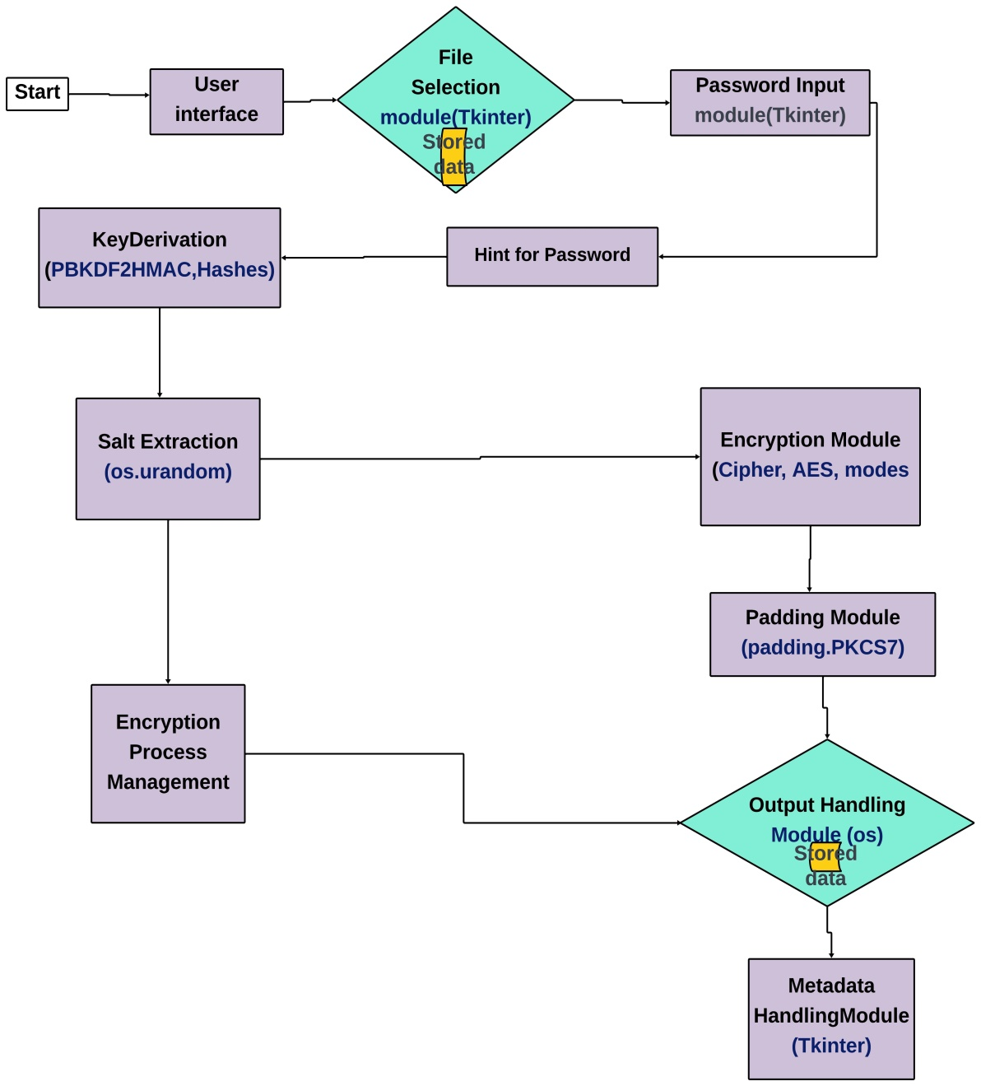
ARCHITECTURAL DIAGRAM: ENCRYPTION

Slide 6
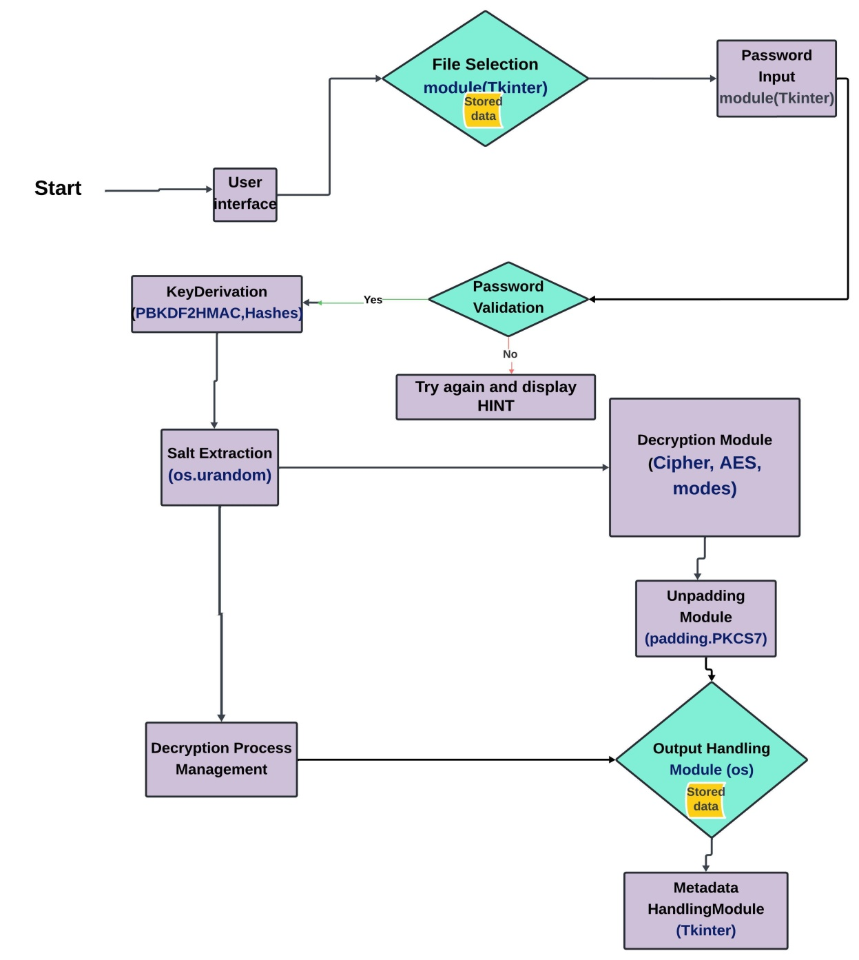
DECRYPTION

Slide 7
ARCHITECTURAL DESCRIPTION
User Interface (Tkinter): Provides the graphical interface for user interaction.
File Selection Module (Tkinter): Allows users to choose files for encryption or decryption.
Password Input Module (Tkinter): Handles user input for passwords.
Password Validation Module (Tkinter): Checks the entered password for validity.
Key Derivation (PBKDF2HMAC, hashes): Derives encryption keys from passwords using PBKDF2HMAC for encryption and decryption processes.
Salt Generation / Extraction Module (os.urandom): Generates and extracts salt for key derivation.
Encryption Module (Cipher, AES, modes): Encrypts data using the AES algorithm with padding.
Decryption Module (Cipher, AES, modes): Decrypts encrypted data using the AES algorithm with unpadding.
Padding Module (padding.PKCS7): Pads data before encryption to ensure it fits the block size.
Unpadding Module (padding.PKCS7): Removes padding after decryption to restore original data.
Output Handling Module (os): Manages file output for encrypted or decrypted files.
Metadata Handling Module (Tkinter): Manages metadata associated with files, such as timestamps and properties.
Encryption Process Management (Coordination): Coordinates the encryption flow from user input to file encryption.
Decryption Process Management (Coordination): Coordinates the decryption flow from user input to file decryption.

Slide 8
TECHNOLOGIES USED
Python: Core programming language for file encryption/decryption functionalities.
Tkinter: GUI library for user interactions (file selection, password input, mode selection).
Cryptography Library: Provides AES-256 encryption, PBKDF2HMAC key derivation, and SHA256 hashing.
os Module: Handles file and directory operations.
Padding Module: Manages data padding/unpadding for AES encryption.
Filedialog (Tkinter): Enables file and directory selection dialogs.
Messagebox (Tkinter): Provides user notifications and error messages

Slide 9
PROJECT LEAD
NAME: THEJASHWINI H A
USN: 1EP21EC107
Frontend (GUI) Development
Design and implement the GUI using Tkinter.
Create file and directory selection dialogs.
Handle user inputs, button click events, and input validation.
Display error messages and success notifications using messagebox.
Integrate with backend functions for encryption and decryption.
Backend (Cryptographic Logic and File Handling)
Implement AES-256 encryption and decryption using the Cryptography library.
Handle key generation with PBKDF2HMAC and SHA256 hashing.
Manage file reading and writing operations.
Implement error handling for cryptographic and file operations.
Enhance security with salting and padding management.

Slide 10
CONCLUSION
Developed a GUI-based file encryptor/decryptor using Python's tkinter and cryptography libraries.
Implemented AES-256 encryption in CBC mode with PBKDF2-derived keys for strong security.
Ensured user-friendly interface with file selection, password input, and optional password hint.
Future improvements could include performance optimization for large files, enhanced security features, and improved user experience with progress indicators and drag-and-drop functionality.
Overall, the project provides a solid foundation for secure file encryption and decryption, poised for further enhancement based on user feedback and evolving security standards.

Slide 11


